Slide 1

DriverPass System Analysis
Bryan Howard
Notes:
[No speaker notes required for this slide.]

Slide 2

System Requirements
Functional Requirements:
Lesson Booking: The system shall allow students to book, modify, and cancel driving lessons through an online interface, ensuring they can schedule time with an available instructor.
User Role Management: The system shall allow administrators to manage user accounts, including adding new users, modifying roles (e.g., students, instructors), and removing users from the system.
Nonfunctional Requirements:
Performance: The system must respond to user actions (e.g., booking a lesson or taking a test) within 2-3 seconds, ensuring a smooth and efficient user experience.
Security: The system shall encrypt all sensitive data, including user passwords and payment details, using industry-standard encryption (SSL/TLS), and ensure role-based access control for different user types (e.g., students, instructors, admins).
Notes:
[In your speaker notes, include an explanation of the different requirements you determined for DriverPass’s system. What are the functional requirements you selected to describe? What are the nonfunctional requirements you selected to describe? Be sure to explain how these requirements meet DriverPass’s needs.]

Slide 3
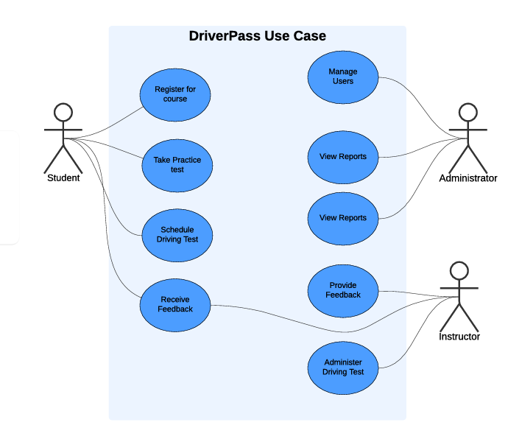
Use Case Diagram
[Insert your use case diagram here.]
Notes:
[Explain your diagram. Who are the different actors in the system? What are the different use cases? How did you account for DriverPass’s needs in your design? In your explanation, keep your audience in mind. Avoid the use of terms like “actors” and “use cases” in your explanation.]

Slide 4
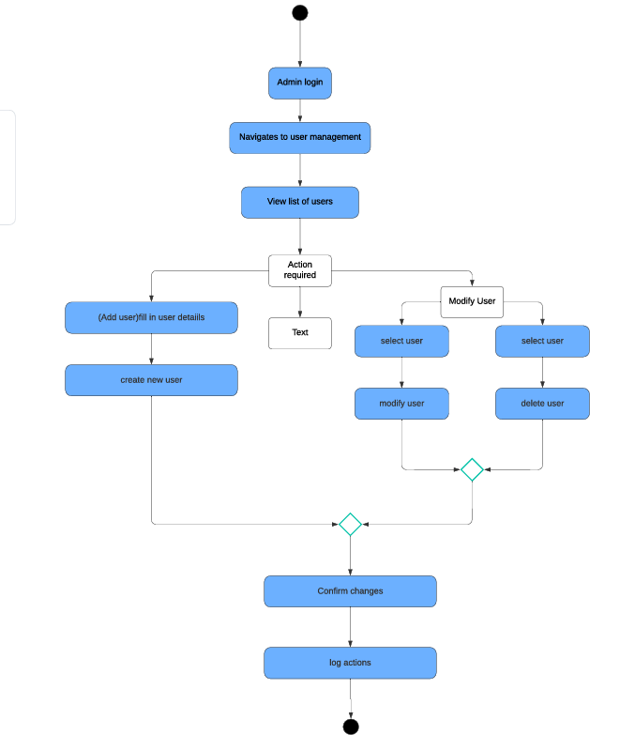
Activity Diagram
Notes:
[Explain your diagram. Which use case are you breaking down? What are the steps for this use case? How did you account for DriverPass’s needs in your design? In your explanation, keep your audience in mind. Avoid the use of technical terms such as “nodes,” “control flows,” and so on.]

Slide 5
Security
How the DriverPass System Design Addresses Security Concerns:
SSL/TLS Encryption: Secures data in transit between clients and servers.
Role-Based Access Control (RBAC): Ensures only authorized access to system features based on user roles.
Password Encryption: Uses strong hashing (e.g., bcrypt) for secure password storage.
Secure User Authentication: Multi-factor authentication (MFA) can be implemented for added protection.
Audit Logs: Tracks user actions for accountability and security monitoring.
Account Lockout: Protects against brute-force attacks by locking accounts after multiple failed login attempts.
Data Backup and Recovery: Regular backups ensure data recovery in case of breaches or data loss.
Notes:
[How did you consider security in your design? In your explanation, keep your audience in mind by avoiding the use of technical terms.]

Slide 6
System Limitations
Limitations of the DriverPass System:
Internet Dependency: Requires a stable internet connection for real-time bookings and test-taking, limiting use in areas with poor connectivity.
Scalability: The initial design may face performance issues with a rapidly growing user base unless further infrastructure scaling is implemented.
Mobile App Unavailable: Currently, the system is designed as a responsive web app, but there is no dedicated mobile application.
Instructor Availability: The system's effectiveness is limited by the availability of instructors, which could cause scheduling delays during high demand.
Limited Payment Processing: Integration with payment gateways may initially be basic, with limited support for advanced payment options like installment plans.
Notes:
[What are the limitations of your design? In your explanation, keep your audience in mind by avoiding the use of technical terms.]

